Slide 1
Business Process Engineering (BPE)

Slide 2
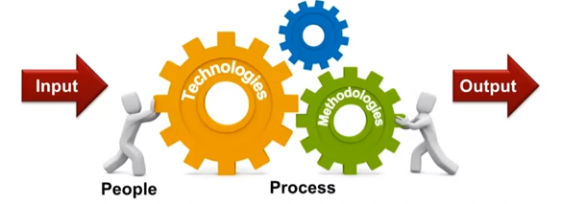
Components
A management approach to continuously improve processes and archive organizational objectives through a set of methodologies and technologies
People and processes are a key part

Slide 3
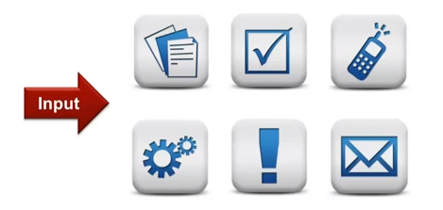
Input
An input can be a form, a document, an image, an approval from a person (employee/customer/ manager can trigger an event), data, alert, mail from a person or a system.

Slide 4
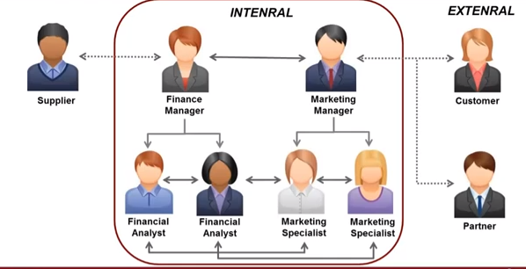
Process Participants
From the same team project, but also cross-functional

Slide 5
Process Activities
Types:
  Value Added - contribute to the process output in a positive way
  Handoff - pass control of the process to another department or organisation
  Control - assure that the processes behave within desired tolerances or specify a validity checkpoint

Slide 6
Process Activities
Examples:
  Planning & strategy
  Analysis
  Design & modeling
  Implementation
  Monitoring & controlling
  Refinement

Slide 7
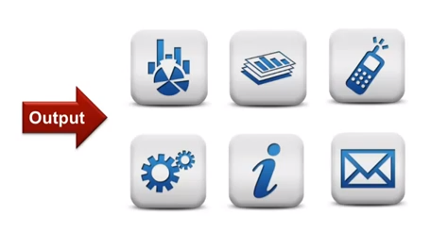
Output
Management dashboard, reports, phones, e-mail alerts from key participants and reviewers
Good outcomes for participants and organization + bring the process to an end

Slide 8
End of Lecture

